Slide 1
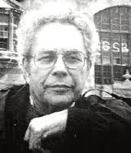
George Segal 20th Century Artist
Study of form, emotion and the surroundings

Slide 2
How to draw your hand in 3D.
https://youtu.be/YNEXzvnD7mI

Slide 3
Objective:
I can analyze and summarize the difference between two and three-dimensional art work.
Collaborate…determine which art work is two-dimensional and three-dimensional.
Share

Slide 4
Two-Dimensional 2D
two-di·men·sion·al
Having two measurements
Height
Width
FLAT

Slide 5
Three-Dimensional 3D
three-di·men·sion·al
Having 3 measurements
Height
Width
Depth
(Walking around it)
FAT

Slide 6
Objective:
I can identify the work of the sculptor, George Segal.
Read Aloud

Slide 7
Philosophy
life-size plaster human sculptures
Human figures in space and related surroundings
Influenced by Edward Hopper
Attention to attitude and
gestures
Rural and urban settings

Slide 8
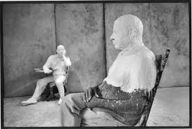
Medium
Cast plaster molds of living figures
Attempt to lock to them in time in constructed environment

Slide 9
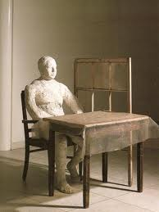
First works examples
Man sitting at a table (1961)
Notice!
simple almost sterile environment
anonymous//depersonalized nature
abstract and impressionistic
What is the emotional quality?
What do you think about when you view this?

Slide 10
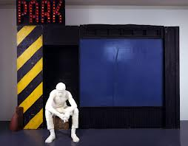
Later works examples
Parking Garage (1968)

Slide 11
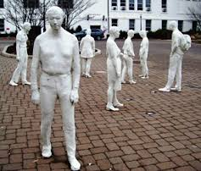
George Segal Sculptures

Slide 12
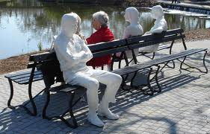
George Segal Sculptures Cont.

Slide 13
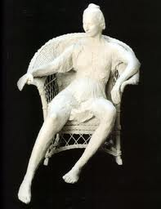
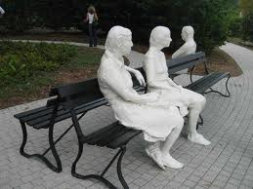
George Segal Sculptures Cont.

Slide 14
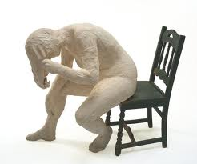
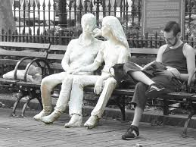
George Segal Sculpture Cont.

Slide 15
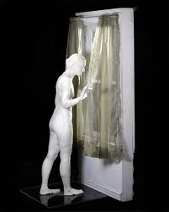
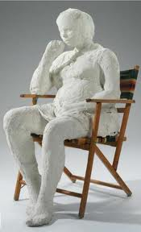
George Segal Sculptures Cont.

Slide 16
Objective:
I can create a plaster cast of a hand or face.
Please write your NAME on the piece of masking tape with a pencil.

Slide 17
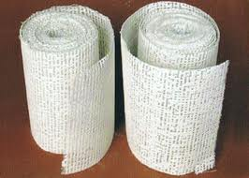
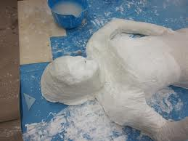
Media
From
this
To this

Slide 18
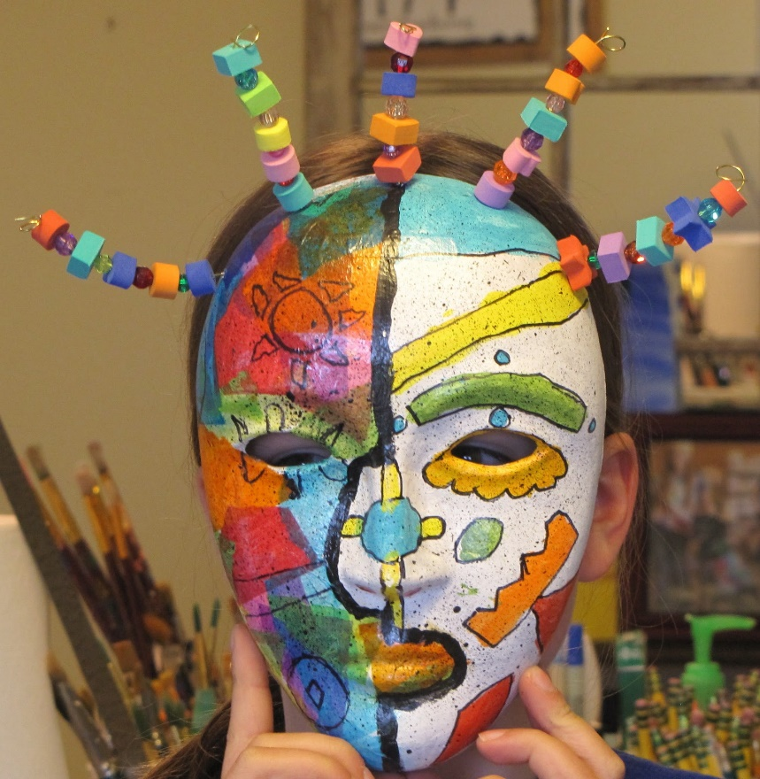
Hand or Face
What could your sculpture represent?

Slide 19
Clean up
Return items to green counter tops
Name is on tape (Ms. Hofmann will label after it dries.
1 person in the sink at a time.
Return to seat for Tweet!
Write 1 complete sentence about something you learned today.

